Slide 1
Workshop 1 – Intro: Anaconda, Jupyter, Pandas, Scikit-Learn
Advanced Analytics and Applications [AAA]
Information Systems for Sustainable Society (is3) | WiSo Faculty | Univ.-Prof. Dr. Wolfgang Ketter | 4/14/21

Slide 2
General Information
GitHub: Workshop material will be uploaded to GitHub
https://github.com/IS3UniCologne/Advanced_Analytics_And_Applications_2021

Slide 3
I
Tools: Python, Anaconda, Jupyter Notebooks
II
Libaries: Numpy, Pandas and Scikit-Learn

Slide 4
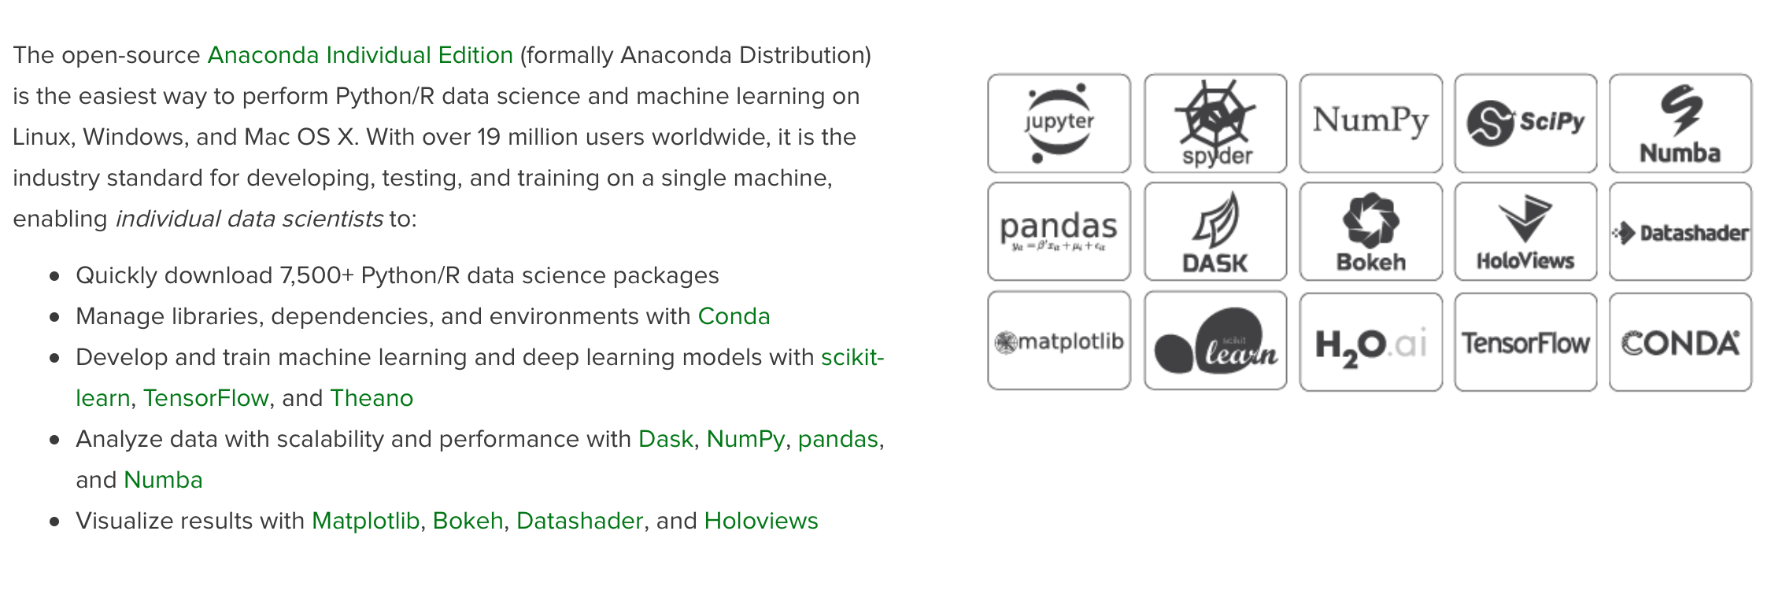
Tools
Anaconda: Why Anaconda?
Source: https://www.anaconda.com/distribution/

Slide 5
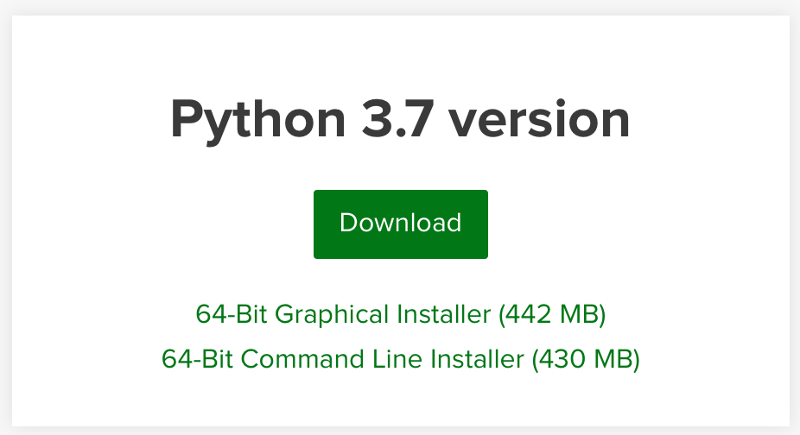
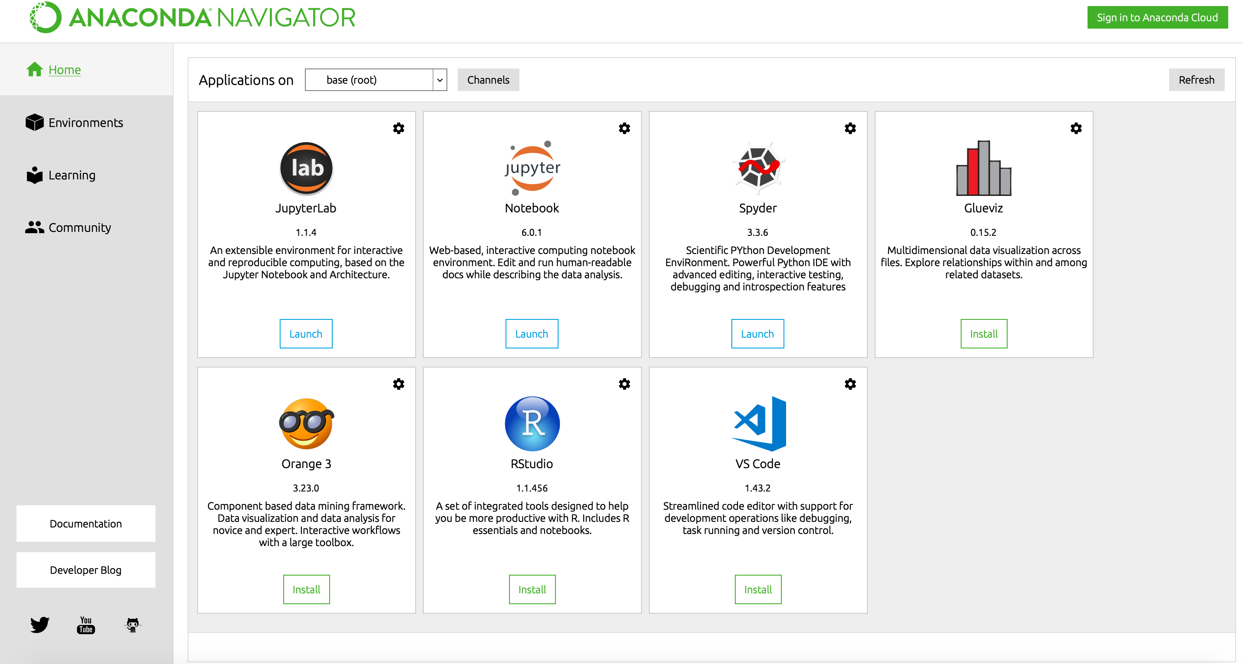
Tools
Anaconda: Installation
1
Download Link– https://www.anaconda.com/distribution/
2
Python Version – 3.7
3
Install on your device – If you have enough space, select all packages and libraries.
4
Start Anaconda-Navigator – If the installation process was successful, you should be able to start “Anaconda Navigator” now.

Slide 6
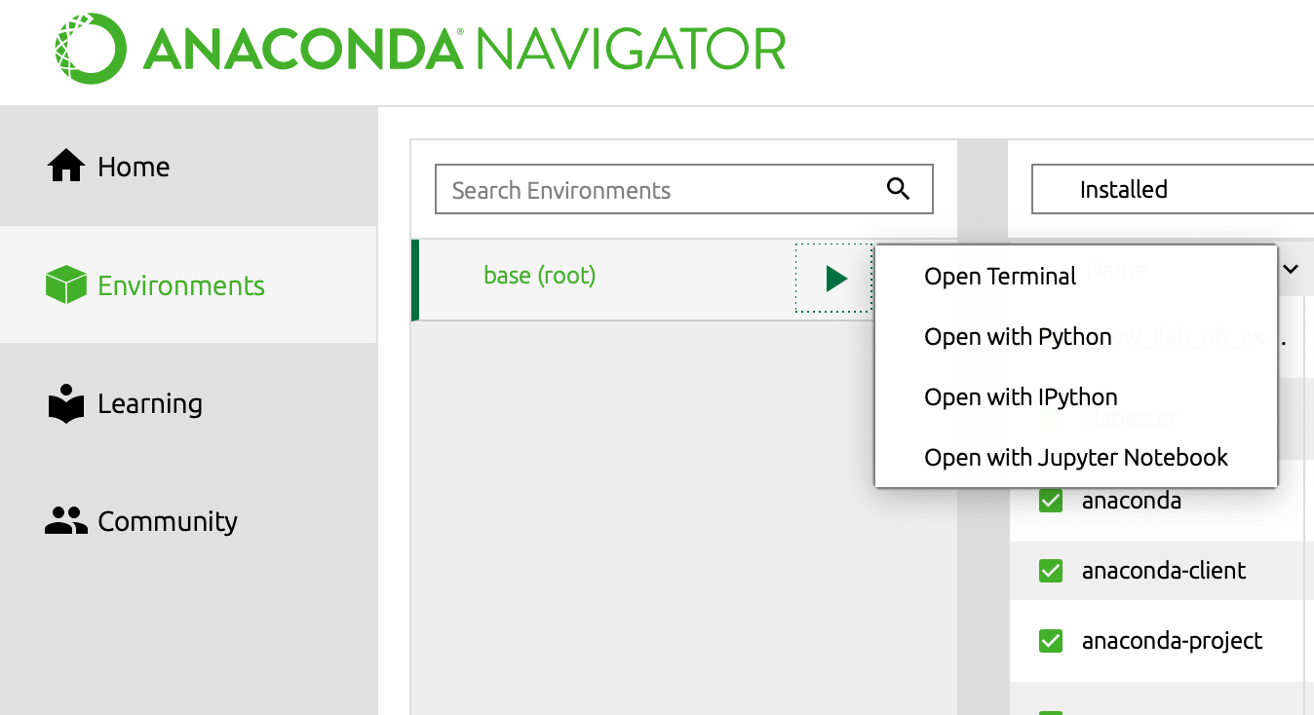
Tools
Jupyter Notebook: Starting a Notebook
1
2
3

Slide 7
I
Tools: Python, Anaconda, Jupyter Notebooks
II
Libaries: Numpy, Pandas and Scikit-Learn

Slide 8
Libraries
Pandas: A Data Scientist's favourite
This is not a tutorial on Python! We expect from you that you are familiar with the fundamentals of Python or at least are willing to learn it by yourselves.
Source: https://www.anaconda.com/distribution/

Slide 9
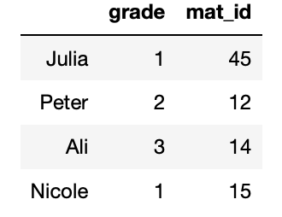
Requirements
Pandas: A Data Scientist's favourite
Main intended use: Read, clean, transform, write and analyze Data
Pandas is built on top of NumPy, and it can seamlessly work with different well-known Data–Science libraries such as SciPy, Matplotlib and Scikit-Learn.
Core concept of Pandas: Series and DataFrame:
Data Frame
Series
Series

Slide 10
Contact
For general questions and enquiries on research, teaching, job openings and new projects refer to our website at www.is3.uni-koeln.de
For specific enquiries regarding this course contact us by sending an email to the IS3 teaching address at is3-teaching@wiso.uni-koeln.de

